Slide 1
電腦視覺與深度學習 (Computer Vision and Deep Learning) Homework 2
TA:
家銘: nckubot65904@gmail.com
Office Hour: 17:00~19:00, Mon.
10:00~12:00, Fri.
At CSIE 9F Robotics Lab.

Slide 2
Notices (1/2)
Copying homework is strictly prohibited!! Penalty: Grade will be zero for both persons!!
If the code can’t run, you can come to our Lab within one week and show that your programming can work. Otherwise you will get zero!!
Due date => Midnight 23:59:59 on 2021/12/22 (Wed.)
No delay. If you submit homework after deadline, you will get 0.
Upload to => 140.116.154.1 -> Upload/Homework/Hw2
User ID: cvdl2021 Password: cvdl2021
Format
Filename: Hw2_StudentID_Name_Version.rar
Ex: Hw2_F71234567_林小明_V1.rar
If you want to update your file, you should update your version to be V2, ex: Hw2_F71234567_林小明_V2.rar
Content: project folder*( including the pictures ) *note: remove your “Debug” folder to reduce file size

Slide 3
Notices (2/2)
Python
Python 3.7 (https://www.python.org/downloads/)
opencv-contrib-python (3.4.2.17)
Matplotlib 3.1.1
UI framework: pyqt5 (5.15.1)
C++ (check MFC guide in ftp)
OpenCV 3.3.1 (https://opencv.org/release.html)
Visual Studio 2015 (download from http://www.cc.ncku.edu.tw/download/)
UI framework: MFC

Slide 4
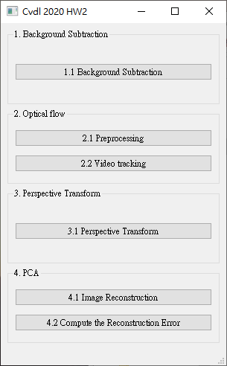
Grading
1. (20%) Background Subtraction (出題：Tony)
2. (20%) Optical Flow (出題：David) 2.1 Preprocessing (10%)
2.2 Video tracking (10%)
3. (20%) Perspective Transform (出題：West)
4. (20%) PCA (出題：Willy)
4.1 Image Reconstruction (10%)
4.2 Compute the reconstruction error (10%)
5. (20%) Dogs and Cats classification Using ResNet50 (出題：育成)
UI example

Slide 5
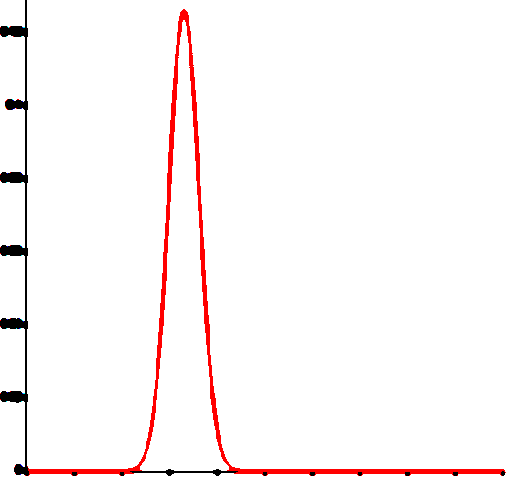
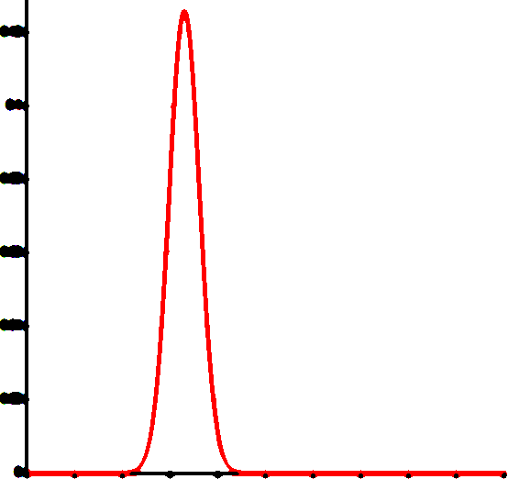
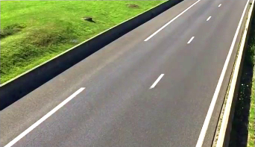
1. (20%) Background Subtraction: Simple Gaussian Model (1/2)
(出題：Tony)
Given: a video in Q1_Image/Traffic.mp4
Requires:
Click the button “1.1 Background Subtraction” to show 3 windows:
Origin video: Traffic.mp4
Mask video: (background: black, foreground: white)
Foreground video
Use first 25 frames to build the background model
DO NOT use OpenCV function: cv2.createbackgroundSubtractor()
1. Build Gaussian model
Frame =0~25
Build one gaussian model at every pixel position
Image height
Each pixel will have a mean
and a standard deviation (total width x height models)
Frame =0~25
Image width
Output: w x h gaussian models (mean and std)
2. Test new pixel belongs to foreground or background:
mean ex: 25
mean ex: 25
Ex:
Mean = 25
Std (standard deviation) = 3
std * 5 ex: 3*5
std * 5 ex: 3*5
new pixel value ex: 28
new pixel value ex: 60
Belongs to Background
Belongs to Foreground

Slide 6
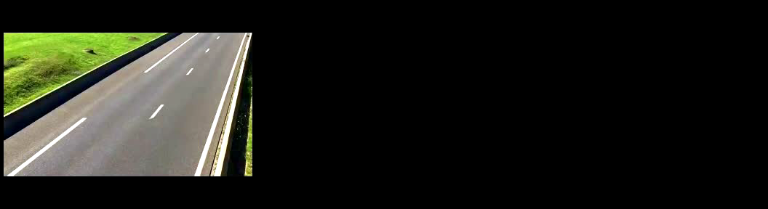
1. (20%) Background Subtraction: Simple Gaussian Model (2/2)
(出題：Tony)
Hint:
Convert video frames to Gray (cv2.cvtColor)
For every pixels in video from 0~25 frames, build a gaussian model with mean and standard deviation (if standard deviation is less then 5, set to 5)
For frame > 25, test every frame pixels with respective gaussian model. If gray value difference between testing pixel and gaussian mean is larger than 5 times standard deviation, set testing pixel to 255 (foreground, white), 0 (background, black) otherwise.
Remove background (cv2.bitwise_and)
Demo video:

Slide 7
2. (20%) Optical Flow (出題：David)
2.1 Preprocessing (10%)
2.2 Video tracking (10%)

Slide 8

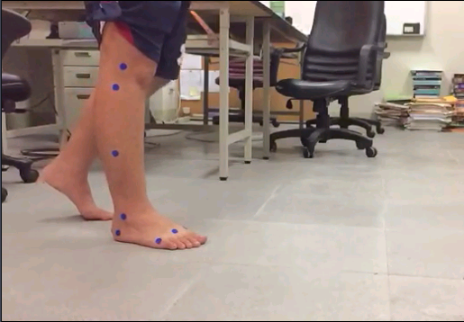
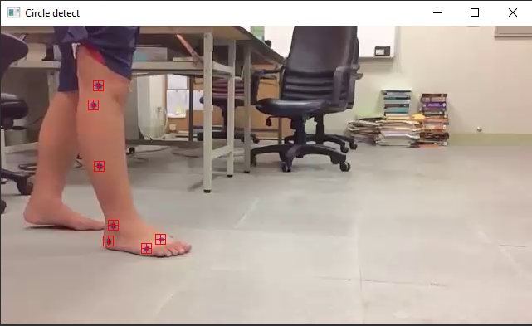
2.1 Preprocessing (10%) (出題：David)
Given a video: optical_flow.mp4
Q: Detect the 7 blue circles and display image with them marked with a red square bounding box and cross mark.
size: 12px
Not this
Center point
Ex:
7 blue circles
(0,0)
x
y
※ Tip: Draw your own marker with opencv functions cv.rectangle() and cv.line()

Slide 9
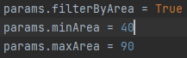
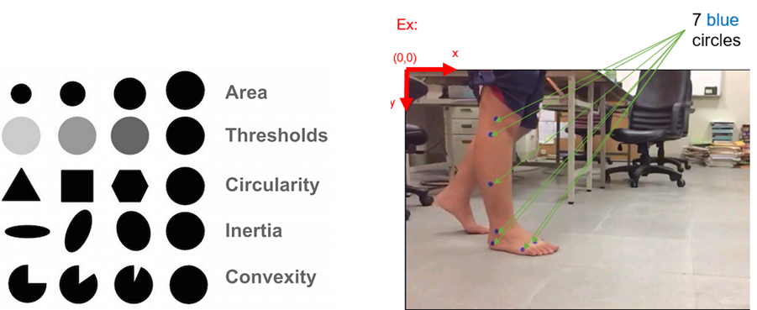
How to detect center points of 7 blue circles (出題：David)
You can use cv2.SimpleBlobDetector() to detect blobs (binary large object), it can filter out blobs by different properties:
Area (of blob in pixels, e.g. 100 px)
Color (gray level, 0 for black, 255 for white)
Circularity (if perfect circle, then it is 1.0)
Inertia (ratio of the minor and major axes from 0.0 to 1.0)
Convexity (if no gap, then it is 1.0)
Minimum and maximum bounds can be chosen. E.g. ->
Colour

Slide 10
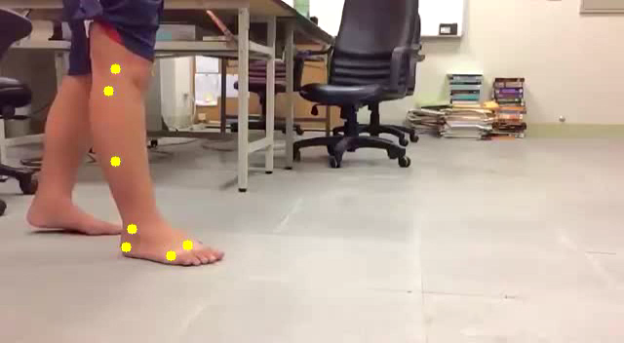

2.2 Video tracking (10%) (出題：David)
Q: Click button to:
(5%) Track the 7 center points on the whole video using OpenCv function cv2.calcOpticalFlowPyrLK. Ex: https://github.com/opencv/opencv/blob/master/samples/cpp/lkdemo.cpp
(5%) Display the trajectory of each of the 7 tracking points throughout the video. Pick a color that is highly visible. Ex: the demo videos bellow.
Tool site:
Load video
Circle detect
Optical flow
Demo videos:
※ Tracking process may have some errors. At least 4-5 points should be tracked with success.

Slide 11
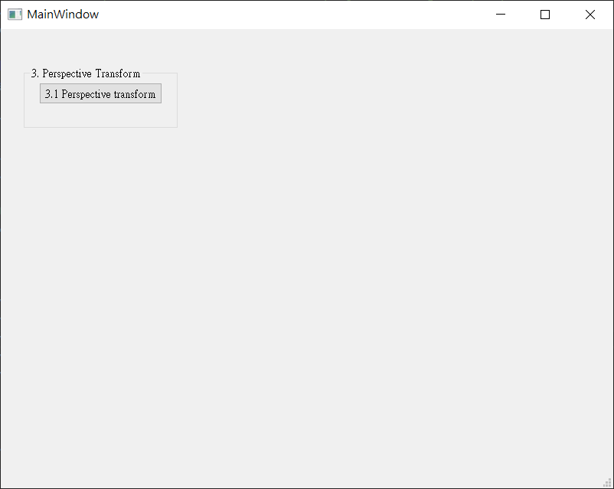
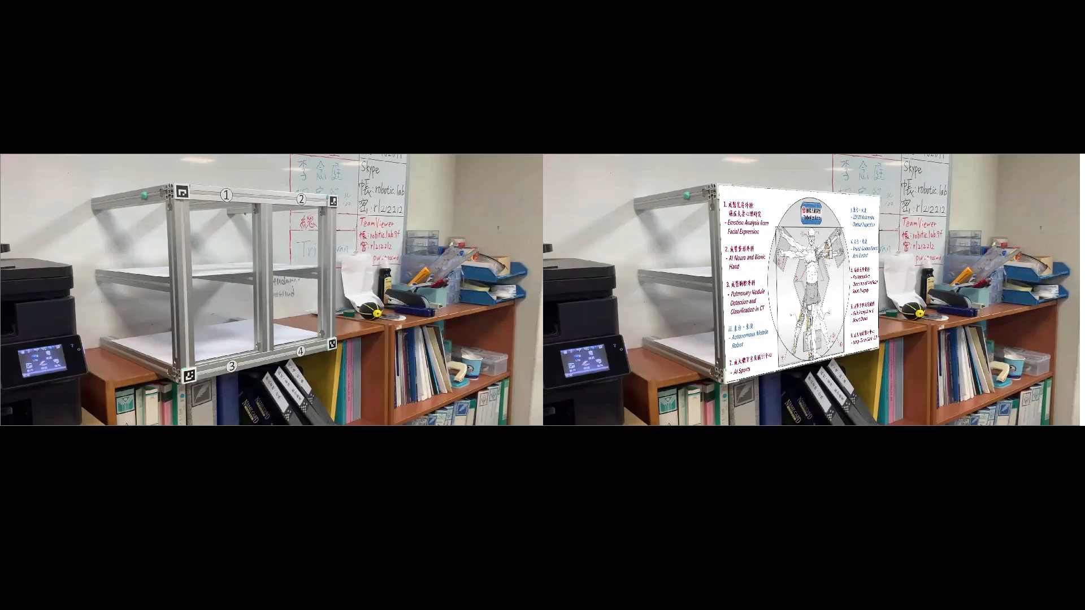
3. (20%) Perspective Transform:
(出題：West)
Given a video: test4perspective.mp4
Q: 1) Click the button “ 3.1 Perspective Transform” to show result video:
Hint : (1) Read the test video and process frame by frame
(2) Detect the ArUco maker inside the frames
(3) Get the pixel position ($x,y$) of four makers in the frame
(4) Do perspective transform
(5) Show result video
Ex:
Next page will show
how to detect ArUco Maker
Please do perspective
transform using
OpenCV method

Slide 12
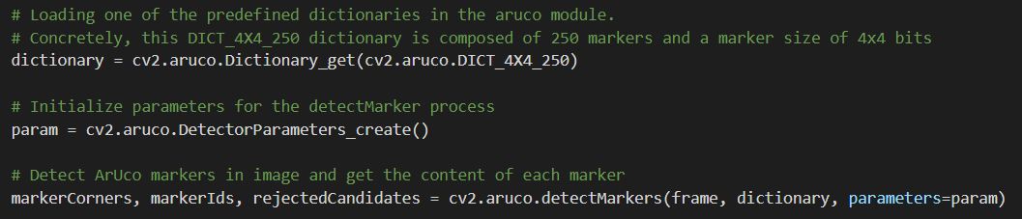
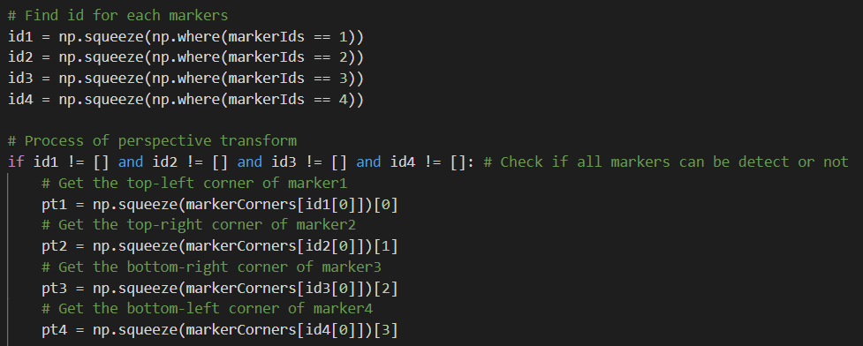
Hints: How to use ArUco Makers (1/2)
(出題：West)
Step 1: Detect ArUco markers in image.
Step 2: Get corner position of each marker.
Get corner position ($x,y$) of makers which’s ID is 1

Slide 13
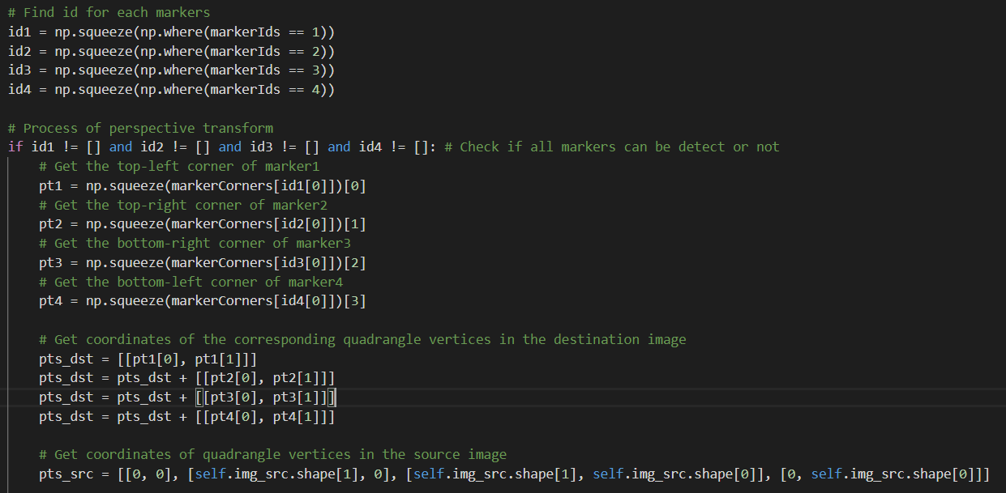
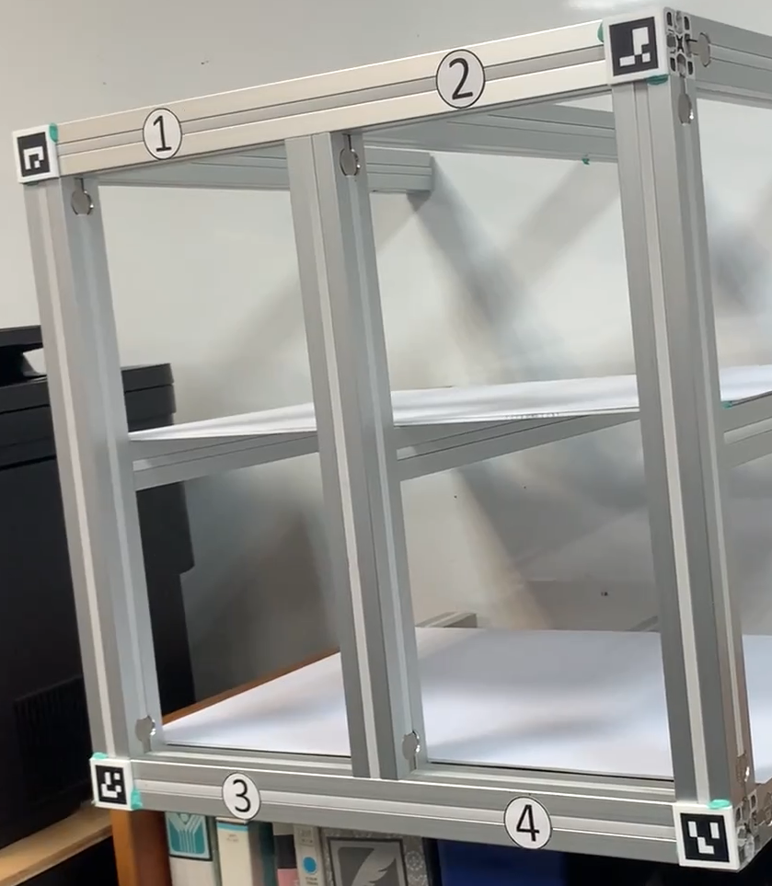
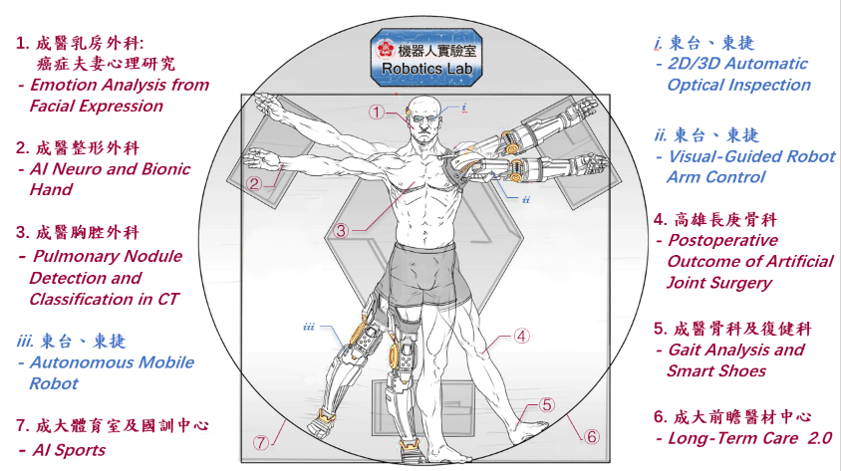
Hints: How to use ArUco Makers (2/2)
(出題：West)
Step 3: Then calculate the four edges of the region you want to perspective
Find markers 1, 2, 3 and 4
Calculate the points for perspective transform
ID 2
pts_dst are 4 image points
ID 1
pts_dst are 4 marker points
ID 4
ID 3

Slide 14

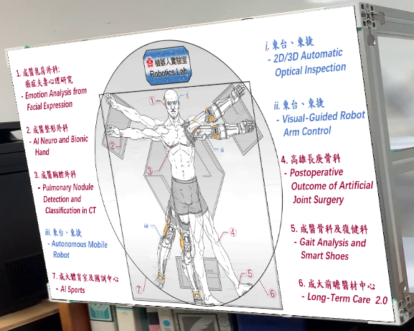
3. (20%) Perspective Transform:
(出題：West)
Do the perspective transform
Hint:
cv.findHomography() and cv.warpPerspective()
(0, 0)
x
ID 2
y
ID 1
ID 4
ID 3
Result

Slide 15
4. (20%) PCA (出題：Willy)
4.1 Image Reconstruction (10%)
4.2 Compute the reconstruction error (10%)

Slide 16
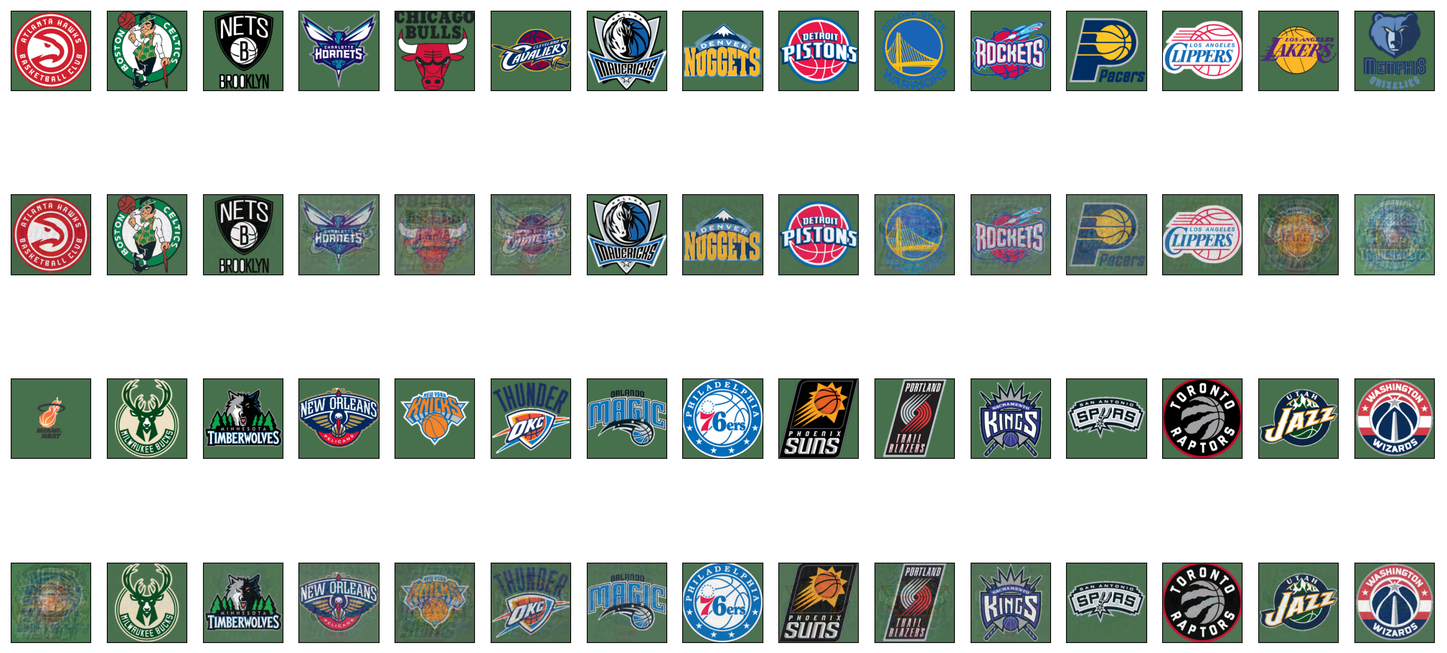
4.1 (10%) PCA - Image Reconstruction (1/2) (出題：Willy)
Given: Images of NBA team logo
Q1: Using PCA(Principal components analysis) to do dimension reduction and then reconstruct, click button “4.1 Image Reconstruction” and show original and reconstructed images.
Hint: Use PCA from python library sklearn.decomposition
Use matplotlib to show all images at once
origin
reconstruction
origin
reconstruction

Slide 17
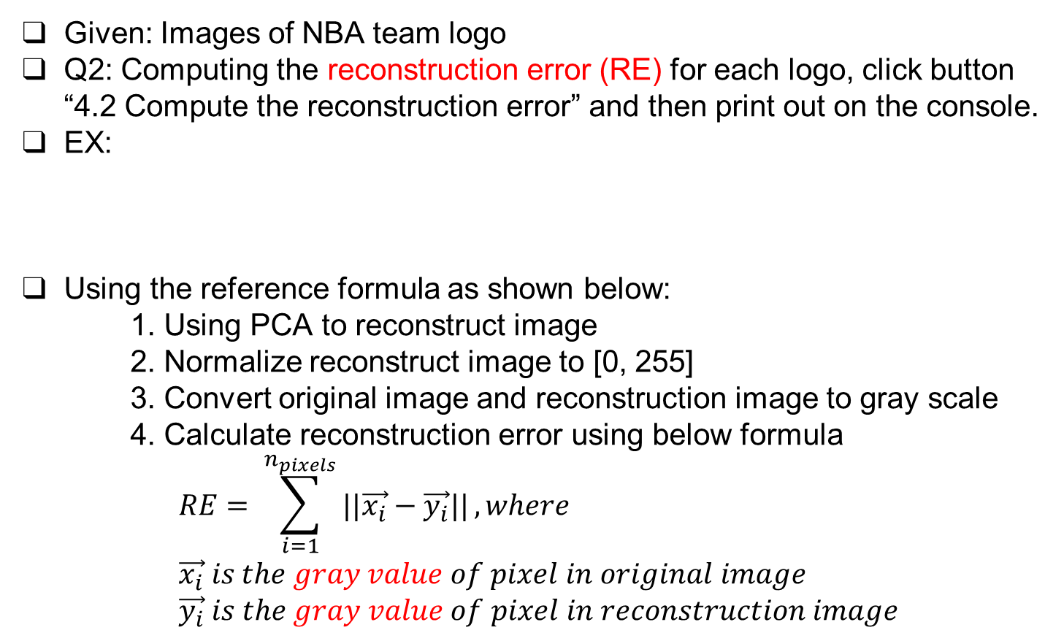
4.2 (10%) PCA - Compute the Reconstruction Error (2/2) (出題：Willy)
Given: Images of NBA team logo
Q2: Computing the reconstruction error (RE) for each logo, click button “4.2 Compute the reconstruction error” and then print out on the console.
EX:
Using the reference formula as shown below:
1. Using PCA to reconstruct image
2. Normalize reconstruct image to [0, 255]
3. Convert original image and reconstruction image to gray scale
4. Calculate reconstruction error using below formula $$RE= \sum_{i=1}^{n_{pixels}}{||\vec{x_{i}}−\vec{y_{i}}||}, where \\ \vec{x_{i}} is the gray value of pixel in original image \\ \vec{y_{i}} is the gray value of pixel in reconstruction image$$
[4214708, 27793154, 26582084, 30843153, 32780303, 30726368, 27606505, 19924229, 30379090, 31211554, 31149559, 30267885, 22194939, 13194457, 30980966, 26039009, 26227989, 32877982, 31474702, 15196576, 18912022, 31835902, 24525323, 29398470, 24614317, 31329428, 28970970, 33122038, 29224809, 27085982]

Slide 18
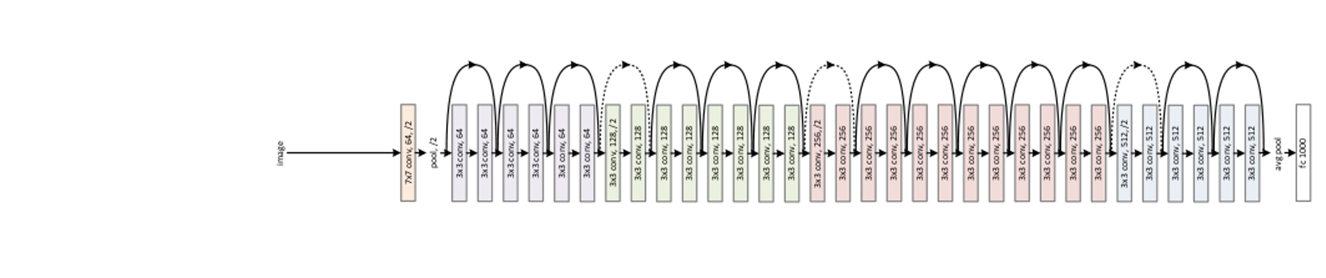
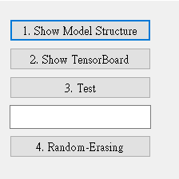
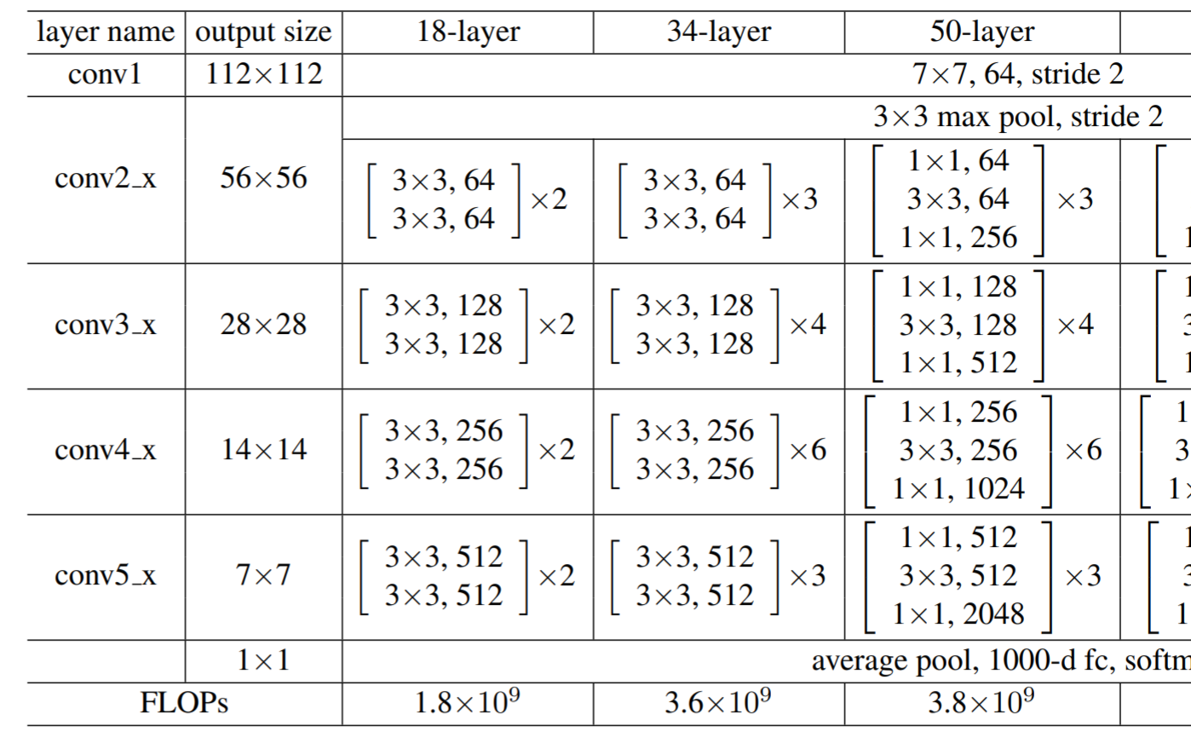
5.0 (20%)Dogs and Cats classification Using ResNet50 (出題：育成)
1) Dataset introduction:
ASIRRA (Animal Species Image Recognition for Restricting Access) is a HIP(Human Interactive Proof) that works by asking users to identify photographs of cats and dogs, that's supposed to be easy for people to solve, but difficult for computers. Now we can use artificial intelligence technology to achieve this goal.
(2) The dataset includes 12501 photos of cats and 12501 photos of dogs. You need to download them in Reference below(R2), and split the training set, validation set and test set using 8:1:1 ratio in both dogs and cats directory.
2) Objective:
You need to use python to write the ResNet network
and complete the questions on the next few pages.
3) Environment Requirement
(1) Python
(2) Tensorflow
(3) Opencv-contrib-python
(4) Matplotlib
Fig. Example UI
Fig. ResNet’s Network Architecture
R. Reference
R1) Deep Residual Learning for Image Recognition
R2) https://www.microsoft.com/en-us/download/details.aspx?id=54765 (ASIRRA)
Fig. ResNet50's Schematic Diagram

Slide 19
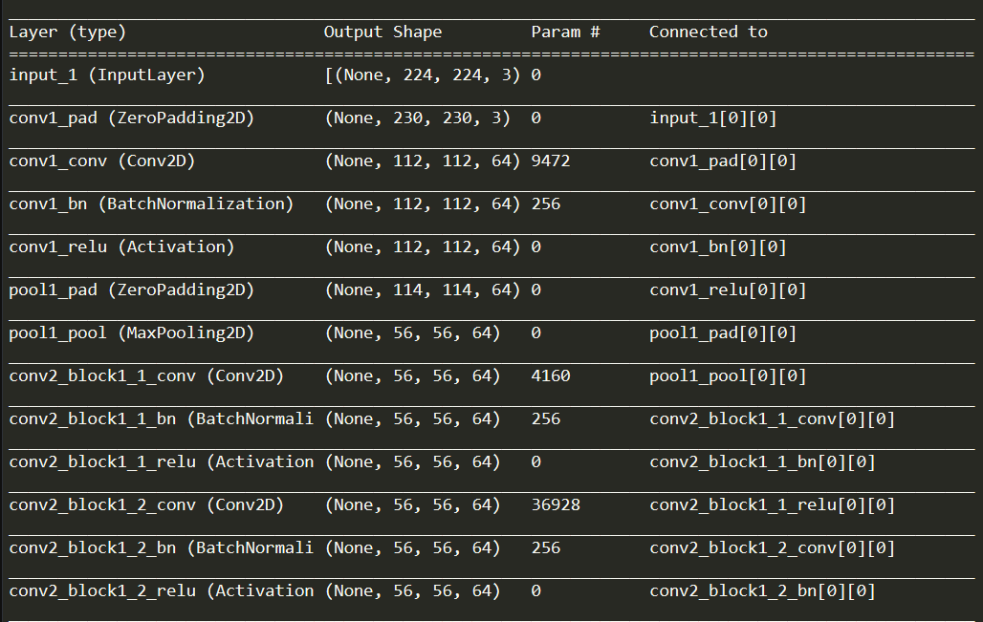
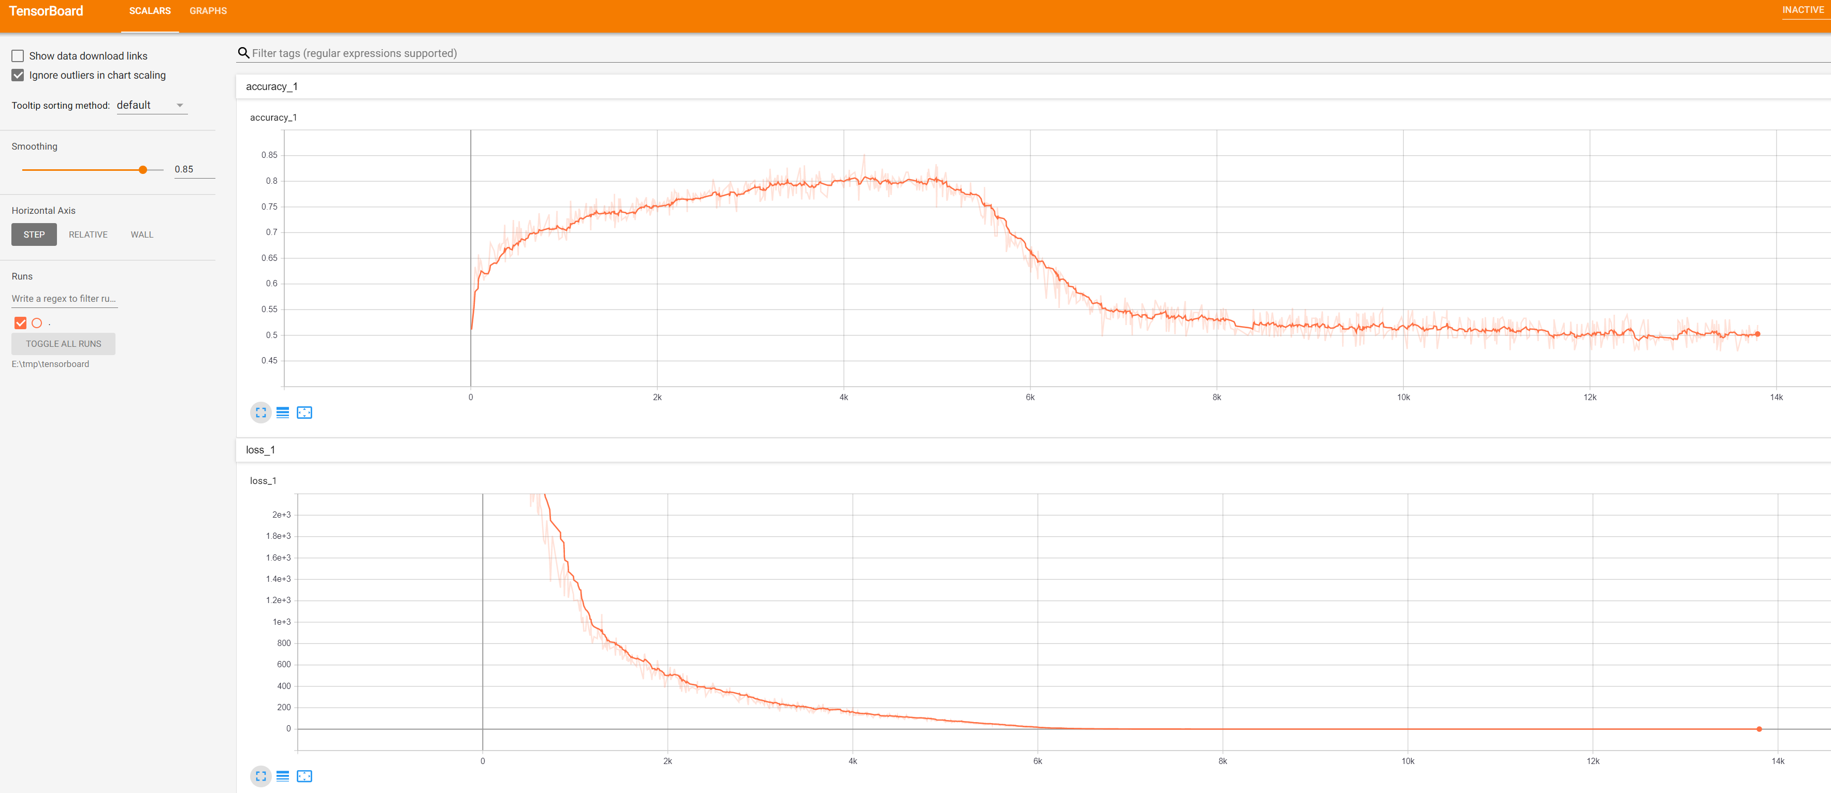
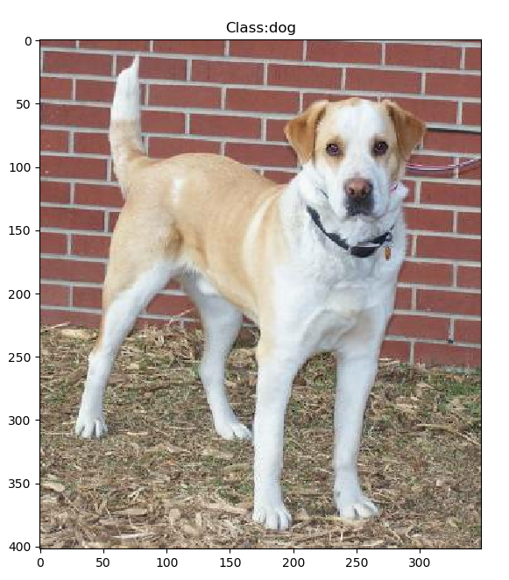
5.1 Construct and show summary of your model structure by printing out on the terminal. (5%)
Fig. Summary of ResNet50
5.2 Training by your computer at home at least 5 epochs and use TensorBoard to monitor, Save the final screenshot of TensorBoard (5%, Use other tools can get 3%).
Fig. Example of training with TensorBoard
5.3 Randomly select a picture from the test set and mark its predicted category.(5%)
Fig. Classification display example

Slide 20
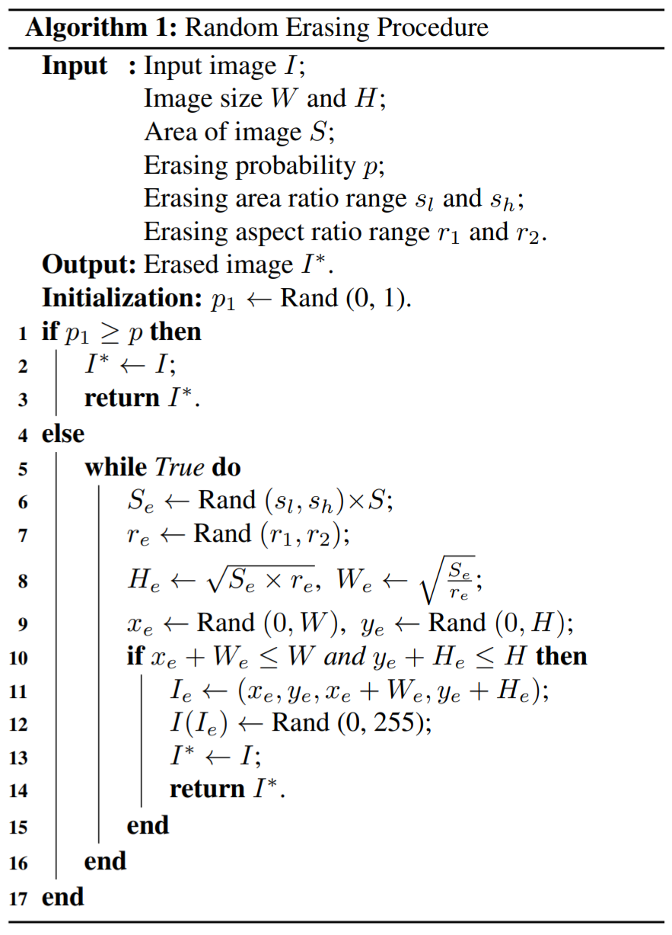
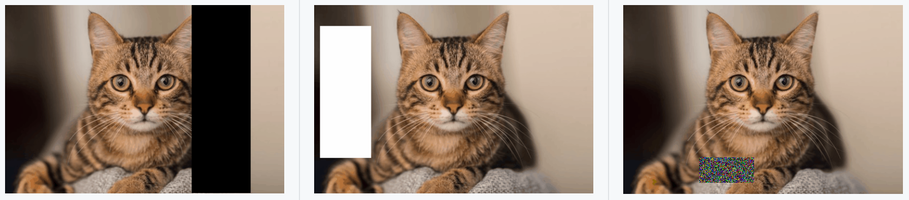
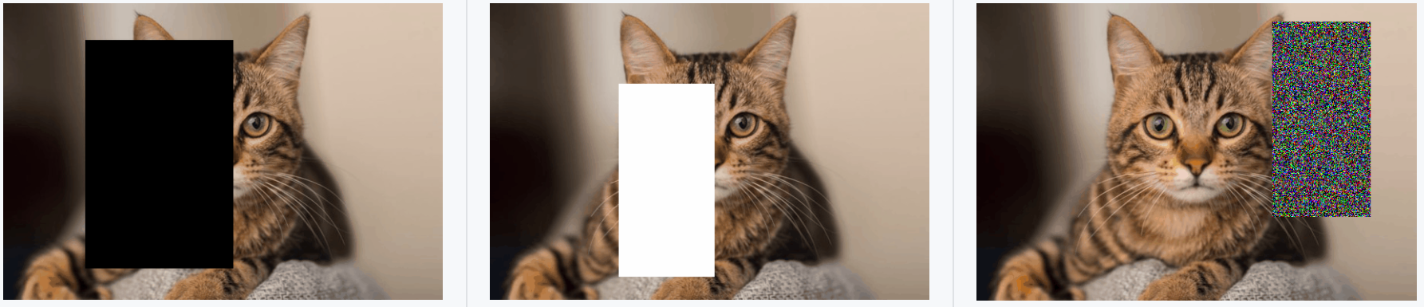
5.4 Improve ResNet50 with Random-Erasing:
Train another model with Random-Erasing data augmentation.
Write the code of Random-Erasing (3%) and draw the comparison table of accuracy, save it as a picture.(2%)
Fig. Random-Erasing algorithm
Accuracy
Fig. Examples of the use of Random-Erasing
R. Reference
Random Erasing Data Augmentation
Fig. Random-Erasing effect comparison example

